Slide 1
Basic Video Processing
Activity 11 Short Report
Lou Josef S. Tan

Slide 2
Tasks
Integration of image processing skills (image segmentation, morphological operations, blob analysis, etc.)
Determination of the gravitational acceleration, g, via basic video processing

Slide 3
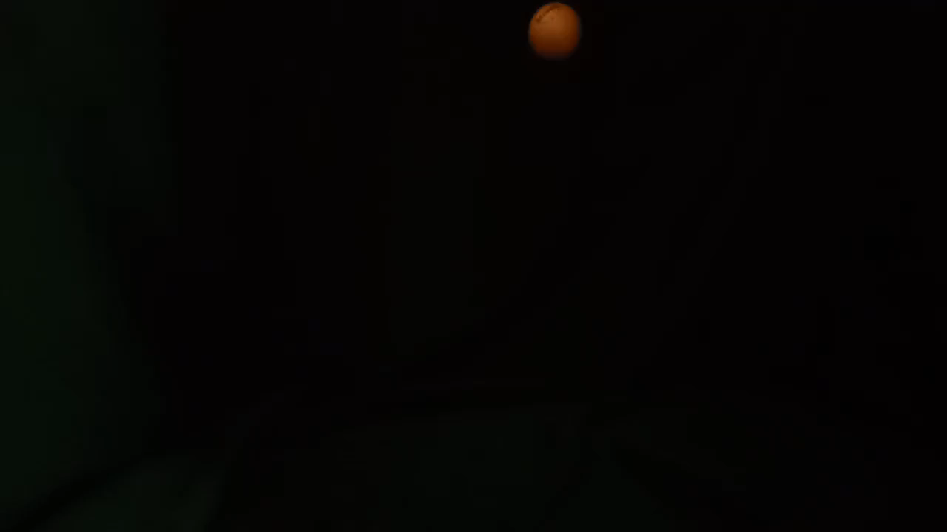
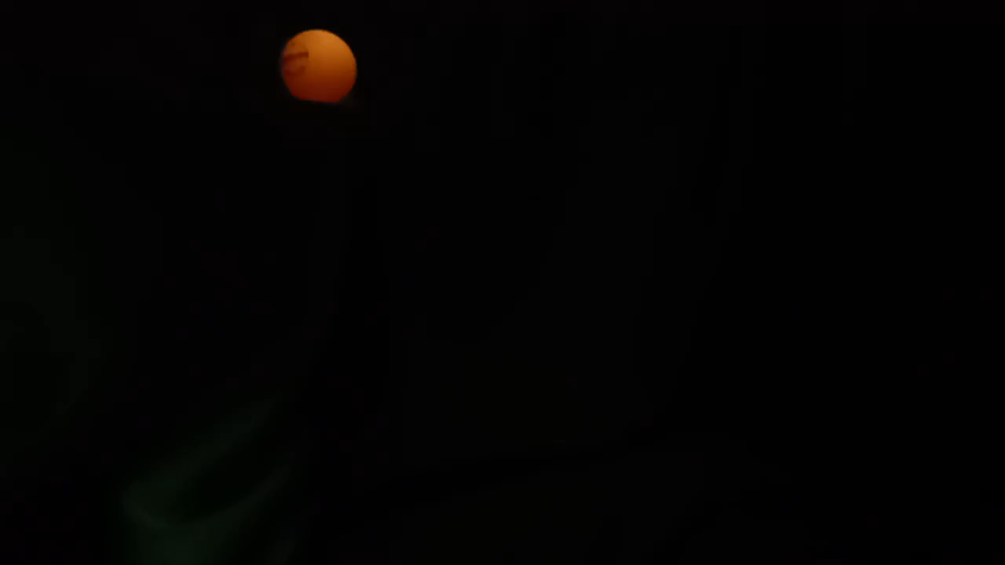
Kinematic Experiment
Using a ping-pong ball of known length (40 mm), two simple kinematic experiments were conducted: ball drop and projectile motion.
x
y
Figure 1. Kinematic experiments: (left) ball drop, (right) projectile motion.

Slide 4
Procedure
Videos were trimmed at frames where: (start) the ball was released, and (end) first landed on the ground.
Figure 2. Trimmed videos: (left) ball drop, (right) projectile motion.

Slide 5
Procedure
Color segmentation was used to segment the ping-pong ball from the background.
Figure 3. Segmented frames: (left) ball drop, (right) projectile motion.

Slide 6
Procedure
The ping-pong ball from some segmented frames appears stretched (which is probably due to the low FPS of the camera used: 30 FPS Oppo F5).
Figure 3. Segmented frames: (left) ball drop, (right) projectile motion.

Slide 7
Procedure
The true position of the ball in these cases are the circles fitted at the end of the stretched segmentations. For the projectile motion, the region of the unnecessary blob was cropped.
Figure 4. Segmented frames: (left) ball drop, (right) projectile motion. Red circle indicates true position of ping-pong ball.

Slide 8
Procedure
The centroids of these blobs were then taken to determine the XY position of the ping-pong ball at each frame.
Figure 5. Final results for segmentation of ping-pong ball, which will be subjected to blob analysis.

Slide 9
Determining g
Listed on the tables below are the converted XY coordinates (using the known diameter of the ball) for the ball drop, and the projectile motion, respectively.
Table 1. Converted coordinates for ball drop.
Table 2. Converted coordinates for projectile motion.
Time [s] | Y position [m]
0.033333333 | -0.001029509
0.066666667 | -0.009571701
0.1 | -0.033449655
0.133333333 | -0.072734263
0.166666667 | -0.122308176
0.2 | -0.188690067
0.233333333 | -0.243528
Time [s] | X position [m] | Y position [m]
0 | 0 | 0
0.033333333 | 0.028855548 | -0.00375957
0.066666667 | 0.059241618 | -0.01934615
0.1 | 0.09064522 | -0.04847635
0.133333333 | 0.123426032 | -0.09481709
0.166666667 | 0.155252687 | -0.15472083
0.2 | 0.183024199 | -0.2136606

Slide 10
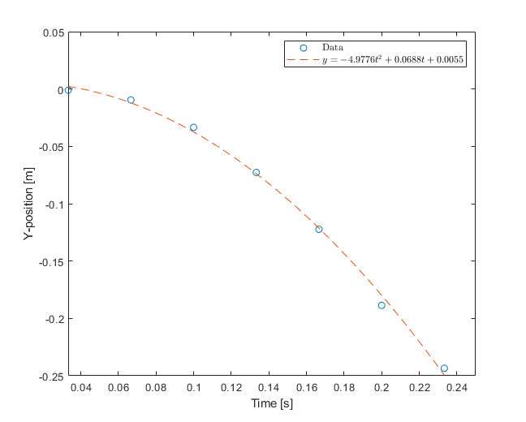

Determining g – Ball Drop
Note that the positions are negative because the reference frame was set at the top.
By fitting a 2nd degree polynomial, we get the equation:
$$y=−4.9776t^{2}+0.0688t+0.0055$$
Recall from our kinematic equations, we have:
$$y=y_{o}+v_{o}t+ \frac{1}{2}gt^{2}$$
(1)
(2)
Figure 6. Position vs. time graph for ball drop.

Slide 11

Determining g – Ball Drop
Then by matching the coefficients of (1) and (2), we get that:
$$\frac{1}{2}g=−4.9776$$
$$g=−9.9552 \frac{m}{s^{2}}$$
$$g≈−9.96 \frac{m}{s^{2}}$$
with a 1.5% deviation from $g_{theo}=−9.81\frac{m}{s^{2}}$
(3)
(4)
(5)
Figure 6. Position vs. time graph for ball drop.

Slide 12

Determining g – Ball Drop
Additionally, it is befitting that:
$$v_{o}=0.0688$$
$$y_{o}=0.0055$$
and rightfully so, we expect that $v_{o}$ be near zero since there is no initial velocity upon the release of the ball, and that $y_{o}$ be near zero since the initial position was at the origin.
(6)
(7)
Figure 6. Position vs. time graph for ball drop.

Slide 13
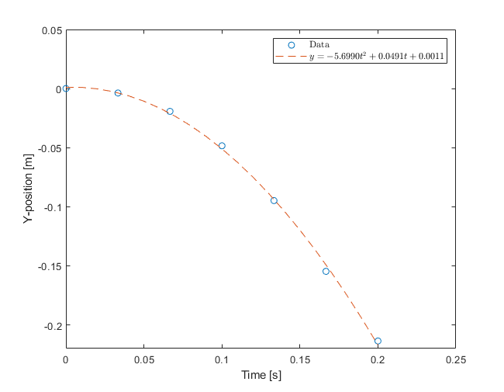

Determining g – Projectile Motion
Once again, the positions are negative because the reference frame was set at the top.
By fitting a 2nd degree polynomial, we get the equation:
$$y=−5.6990t^{2}+0.0491t+0.0011$$
Recall from our kinematic equations, we have again equation (2).
(8)
Figure 7. Y-position vs. time graph for projectile motion.

Slide 14

Determining g – Projectile Motion
Then by matching the coefficients of (8) and (2), we get that:
$$\frac{1}{2}g=−5.6990$$
$$g=−11.338 \frac{m}{s^{2}}$$
$$g≈−11.34 \frac{m}{s^{2}}$$
with a 15.6% deviation from $g_{theo}=−9.81\frac{m}{s^{2}}$
(9)
(10)
(11)
Figure 7. Y-position vs. time graph for projectile motion.

Slide 15

Determining g – Projectile Motion
Once again, it is befitting that:
$$v_{oy}=0.0491$$
$$y_{o}=0.0011$$
since we expect that there be no initial velocity in the Y-direction upon the release of the ball, and that the initial position was at the origin.
(12)
(13)
Figure 7. Y-position vs. time graph for projectile motion.

Slide 16
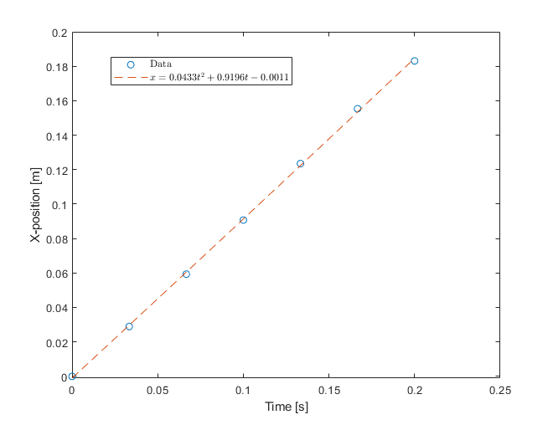

Determining g – Projectile Motion
The position vs. time graph in the X-direction is also shown.
By fitting a 2nd degree polynomial, we get the equation:
$$x=0.0433t^{2}+0.9196t−0.0011$$
The coefficients were again matched with those of equation (2), only this time we just have $g$ as $a$.
(14)
Figure 8. X-position vs. time graph for projectile motion.

Slide 17

Determining g – Projectile Motion
In doing so, we get the following:
$$a=0.0866 \frac{m}{s^{2}}$$
$$v_{ox}=0.9196 \frac{m}{s}$$
$$x_{o}=−0.0011$$
and rightfully so, we expect that $a$ be near zero since there must be no acceleration in the X-direction, and that the initial position, $x_{o}$, was at the origin.
(15)
(16)
(17)
Figure 8. X-position vs. time graph for projectile motion.

Slide 18
Evaluation
I give myself a score of 10/10 for producing all required output, and applying the image processing skills I have learned to determine the gravitational acceleration, g, from the two kinematic experiments conducted.
I would like to acknowledge my groupmates for this activity: Andy, Rhei, Yego, and Kim, for the experiments, brainstorming, and calculations.

